Slide 1
Cutting Edge Advanced Workbook Module 1 p.24-25
Writing a music review

Slide 2
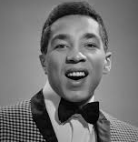
Smokey Robinson was one of the leading American songwriters of the 1960s, known for the clever wordplay of his lyrics. One of his most famous songs, is The tears of a clown, originally a hit in 1967.1967.
Writing a music review

Slide 3
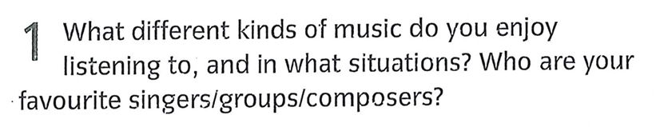

Slide 4
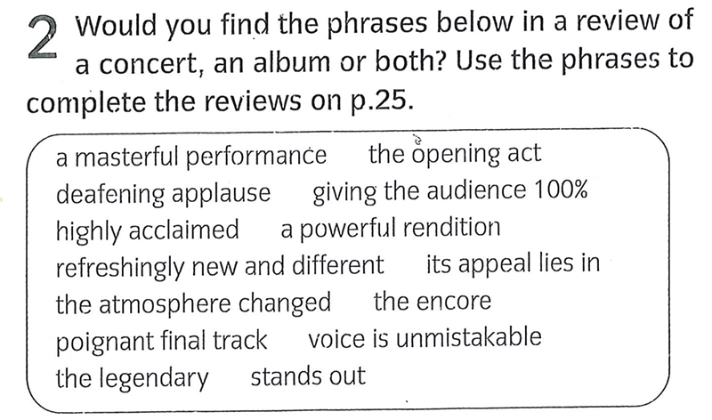

Slide 5


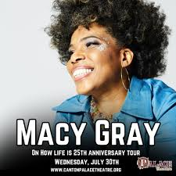
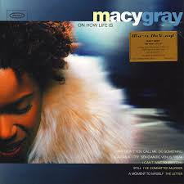

Slide 6
Macy Gray’s show last Friday did not get off to an auspicious
start. Technical difficulties, extra-strict security and an hour-long wait between 1) ................................ and Macy Gray’s set made the audience impatient and rather listless.
However, the moment the singer and her band appeared,
2) ............................................... from lethargic to electric. Macy Gray came on in a shimmering red outfit and her 13-piece band were all dressed in white.
The show opened with 3) ........................................ of Do Something, one of the most danceable tunes on the debut album On How Life Is, and suddenly everyone was on their feet dancing, as if pulled by a mysterious force.
the opening act
the atmosphere changed
a powerful rendition

Slide 7
a masterful performance
Ms Gray went on to give 4) ……………………...………….. Belting out her personal views on life, relationships and romance with a fiery passion. As well as the originals, she performed an array of cover versions which demonstrated her wide variety of musical influences. The best of these were the Beatles’ With a Little Help from my Friends and Doris Day’s Que Sera Sera, but whatever she sang, it was clear that Gray was 5) .............................................. and was getting back the same. When the band finally launched into I Try, which they had saved until the end of 6)........................, the crowd went wild with sang along enthusiastically and very loudly with all the choruses.
The show ended with 7) ..................................... and chanting from fans demanding another encore, but Ms Gray has enough experience to know: always leave them wanting more. I know
that certainly did.
giving the audience 100%
the encore
deafening applause

Slide 8
The voice of Macy Gray is a wonderful thing. It can be sugar sweet on one song, harsh and scratchyon another. The obvious comparison is to 8) ............................. Billie Holiday, but there are traces of other influences too, such as Nina Simone and Tina Turner. Yet in the end, Macy Gray sounds like no one but herself: within seconds of any song on her 9) ............................., debut album On How Life Is, the 10) ......................................... . Featuring confessional lyrics sung in a distinctive ‘earthy’ style, and a unique blend of hip hop, soul and rock, the album appeals across age and musical boundaries. It takes everything from breezy ballads to aggressive dance tunes and makes them sound
11) ............................. . Of the ballads, the hit I Try definitely
12) ......................: a hymn to the joy and pain of romantic dependence, part of 13) ............................. the catchy chorus, which showcases Gray’s vocal talent.
the legendary
highly acclaimed
voice is unmistakable.
refreshingly new
stands out
its appeal lies in

Slide 9
Other tracks which deserve a mention are the smoky ballad, Still, reminiscent of early Aretha Franklin, the comical I’ve Committed Murder, one of the album’s up-tempo songs, and the 14) ........................................., the Letter.
On How Life Is sounds like a ride through the neighbourhoods of contemporary Los Angeles: roll down your window, and you can hear Macy Gray’s roots and her inspirations. And if you haven’t got this inspiring album, drive on down to the record shop and buy it now.
Rating ★★★★★
poignant final track

